Slide 1
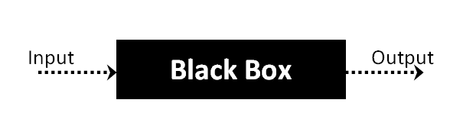
Black-Box Testing Techniques: 1.Decision Tabel Testing 2.Graph base Testing

Slide 2
Graph-Based Testing:
This technique of Black box testing involves a graph drawing that depicts the link between the causes (inputs) and the effects (output), which trigger the effects.
This testing utilizes different combinations of output and inputs. It is a helpful technique to understand the software’s functional performance, as it visualizes the flow of inputs and outputs in a lively fashion.

Slide 3
Decision Table Testing:
In some instances, the inputs combinations can become very complicated for tracking several possibilities.
Such complex situations rely on decision tables, as it offers the testers an organized view about the inputs combination and the expected output.
This technique is identical to the graph-based testing technique; the major difference is using tables instead of diagrams or graphs.

Slide 4
->Register Component Actions And Their Descriptions:-
Actions | Description
C1 | Input Field-Full Name
C2 | Input Field-E-Mail
C3 | Input Field-Password
E1 | Redirected To Home Page
E2 | Display-’Name Field Is Required’
E3 | Display-’E-Mail Field is Required’
E4 | Dissplay-’Password Field is Required’

Slide 5
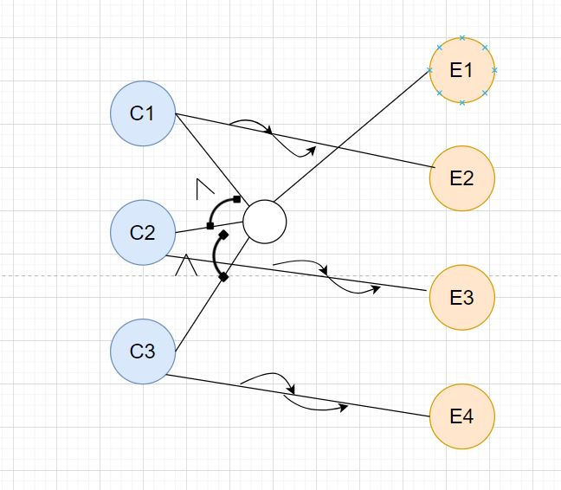
Graph:
Actions | Description
C1 | Input Field-Full Name
C2 | Input Field-E-Mail
C3 | Input Field-Password
E1 | Redirected To Home Page
E2 | Display-’Name Field Is Required’
E3 | Display-’E-Mail Field is Required’
E4 | Dissplay-’Password Field is Required’

Slide 6
DECISION TABLE:-
Actions | Test-Case-1 | Test-Case-2 | Test-Case-3 | Test-Case-4
C1 | NO | NO | YES | YES
C2 | NO | YES | NO | YES
C3 | NO | YES | YES | NO
E1 | YES | NO | NO | YES
E2 | NO | YES | NO | YES
E3 | NO | NO | YES | NO
E4 | NO | NO | NO | YES

Slide 7
Chat-Bot: Actions And Description
Actions | Descriptions
C1 | Input Verification
C2 | Entity Verification
C3 | Indent Verification
C4 | Passing the Condition

Slide 8
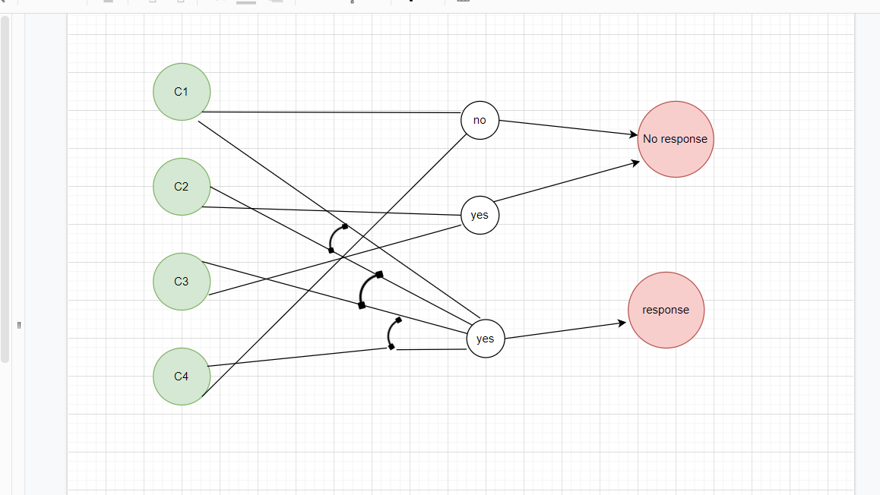
Graph:

Slide 9
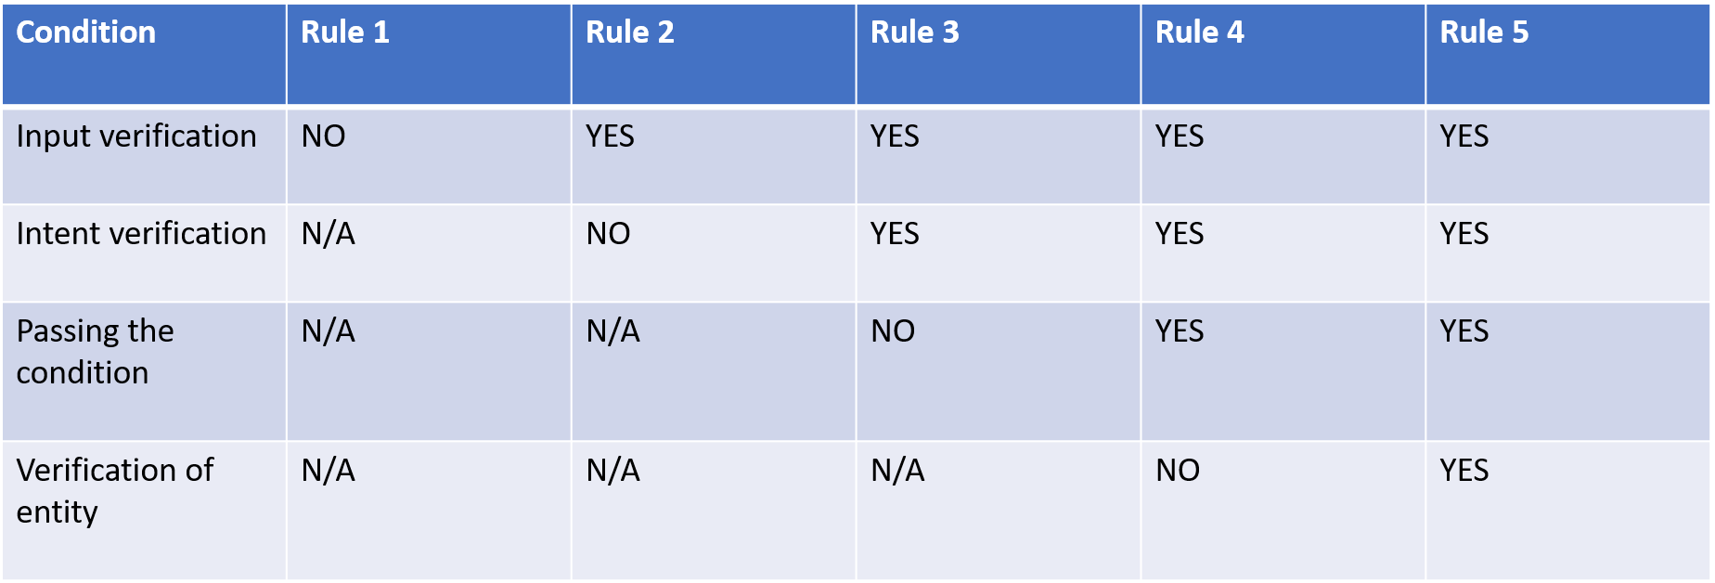
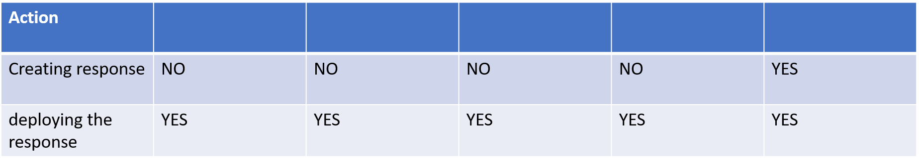
Decision Table:

Slide 10
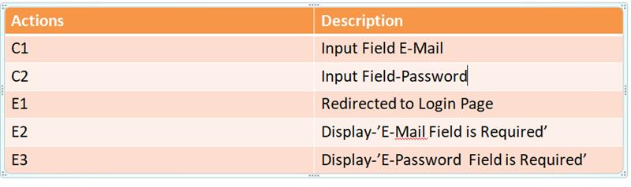
->Login Component Actions And Description

Slide 11
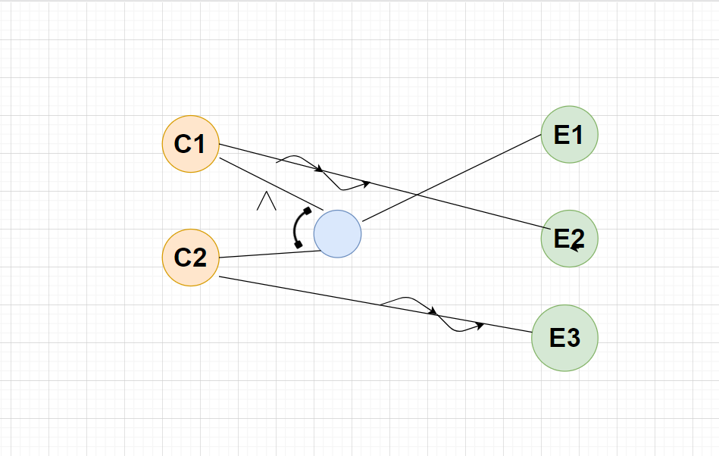
Graph:

Slide 12
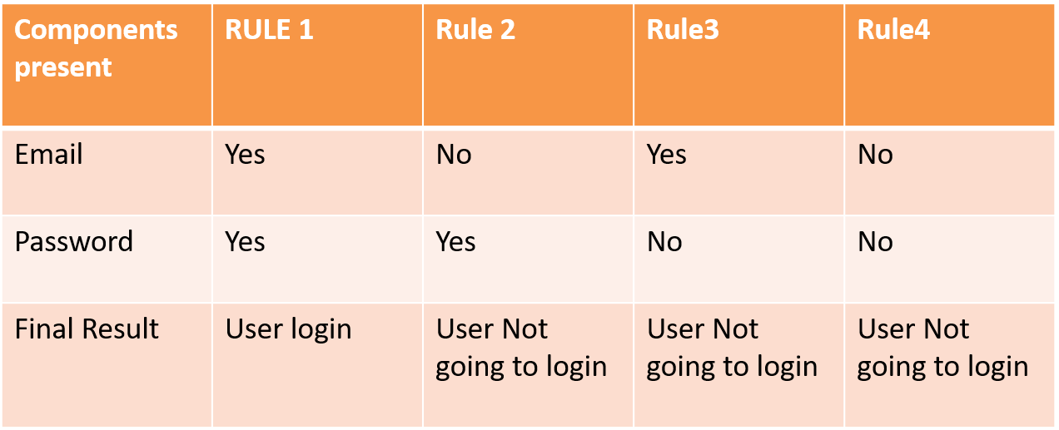
Decision Table:

Slide 13
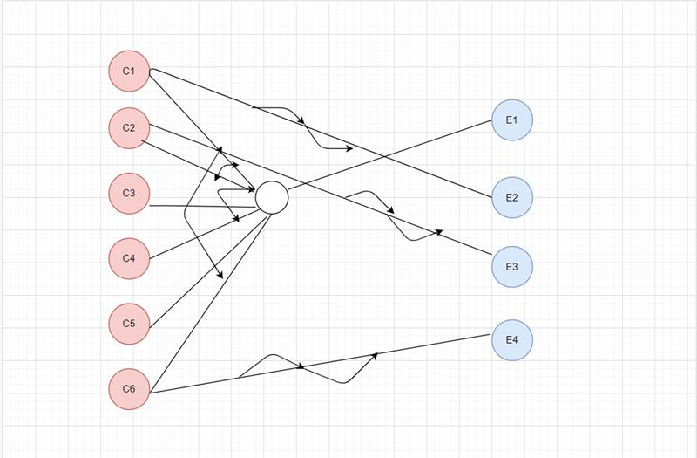
Cash On Delivery Checkout Component: Graph:

Slide 14
DECISION TABLE FOR CASH ON DELIVERY CHECKOUT PAGE:
 | RULE1 | RULE2 | RULE3 | RULE4
CONDITION
FULL NAME | Yes | Yes | Yes | No
EMAIL | Yes | Yes | No | No
ADDRESS | Yes | Yes | Yes | No
CITY | Yes | No | No | No
STATE | Yes | Yes | Yes | No
ZIP | Yes | Yes | No | No
ACTION
Cash on delivery | Yes | No | No | No

Slide 15
DECISION TABLE FOR CARDS ACCEPTED CHECKOUT PAGE:
 | RULE1 | RULE2 | RULE3 | RULE4 | RULE5 | RULE6 | RULE7
FULL NAME | Yes | Yes | Yes | Yes | No | Yes | No
EMAIL | Yes | Yes | Yes | Yes | Yes | Yes | No
ADDRESS | Yes | Yes | No | No | No | Yes | No
CITY | Yes | Yes | No | Yes | Yes | Yes | No
STATE | Yes | Yes | Yes | Yes | No | Yes | No
ZIP | Yes | No | No | No | No | Yes | No
Name on card | Yes | Yes | No | No | Yes | No | No
Expiry month | Yes | Yes | Yes | Yes | Yes | No | No
Expiry year | Yes | Yes | No | Yes | Yes | No | No
CVV | Yes | Yes | Yes | Yes | Yes | No | No
Action
Continue to checkout | Yes | No | No | No | No | No | No

